Slide 1
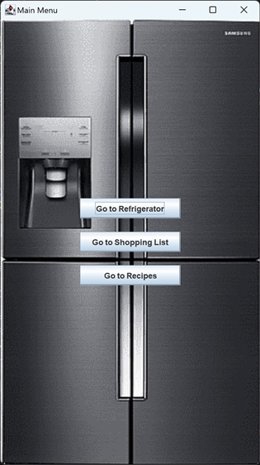

iFridge
Software Engineering- Final Project
Yuval Harary
Paz Snapir
Malachi Vinizky
Rotem Danino

Slide 2
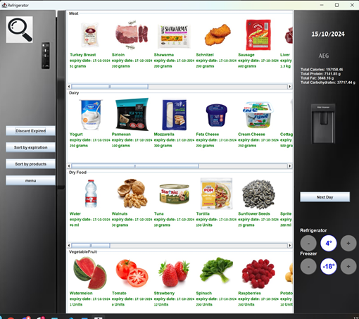
What is iFridge?
iFridge is an app that helps you keep track on your
Groceries, in a simple & convenient way.
Simple tracking of Groceries inventory and
expiration dates
Fast and convenient grocery list update
Information and access to favorite recipes
Detailed nutrition values

Slide 3

Milestones & Constraints

Slide 4
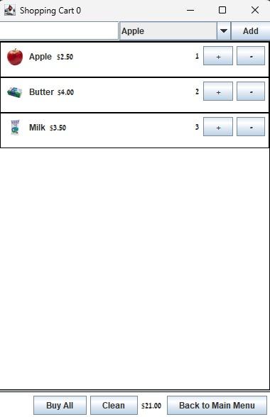
Functionality
Keep track of the Groceries inventory (approximated) and expiration dates
A notification system alerting about a missing or expiring products
Accessible and easy to update grocery list
An updated list of recipes based on available fridge ingredients
Create a favorite recipes collection, and add missing ingredients to shopping list
Detailed nutrition values

Slide 5
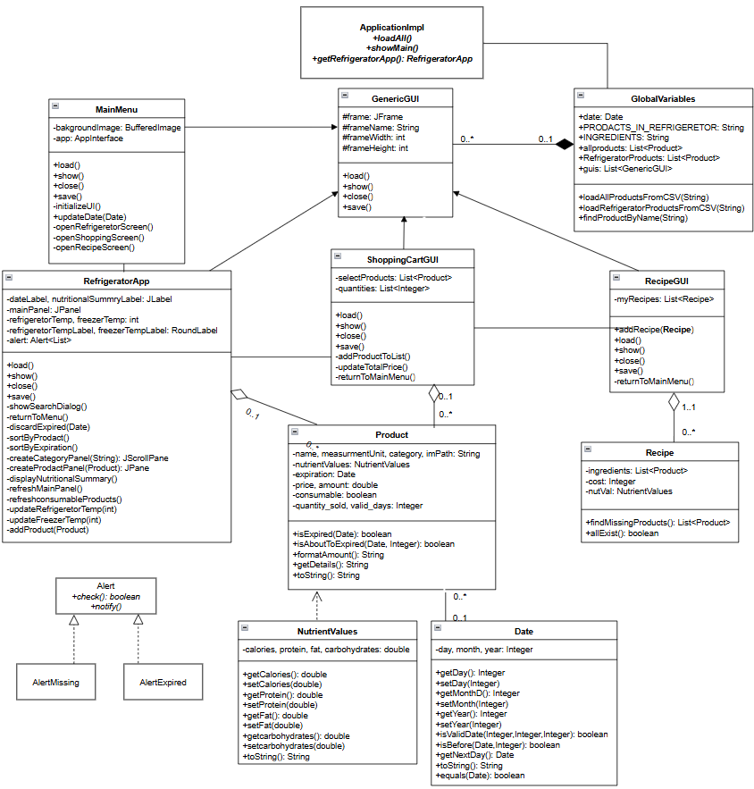
UML

Slide 6
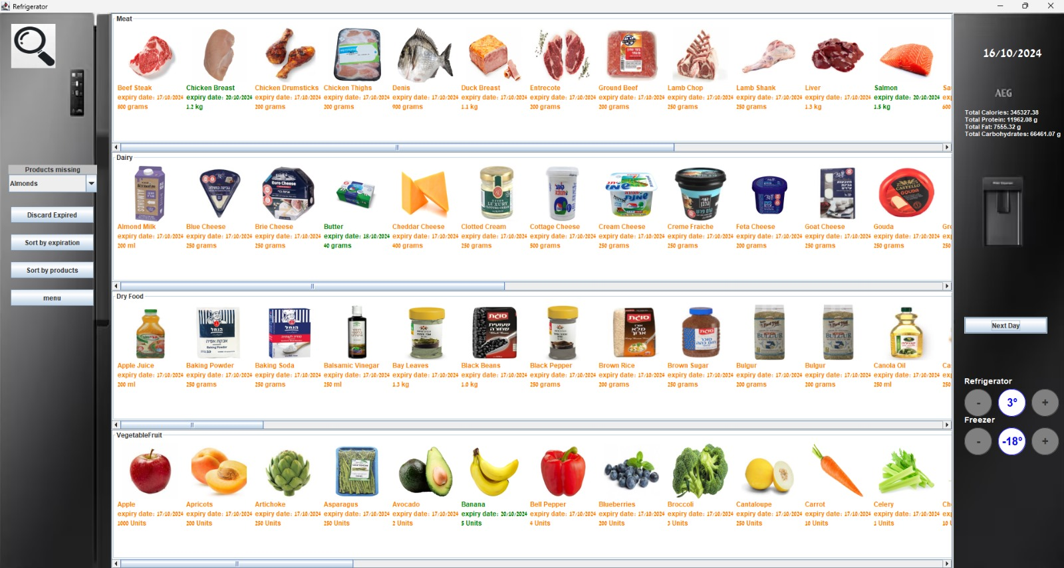

Slide 7
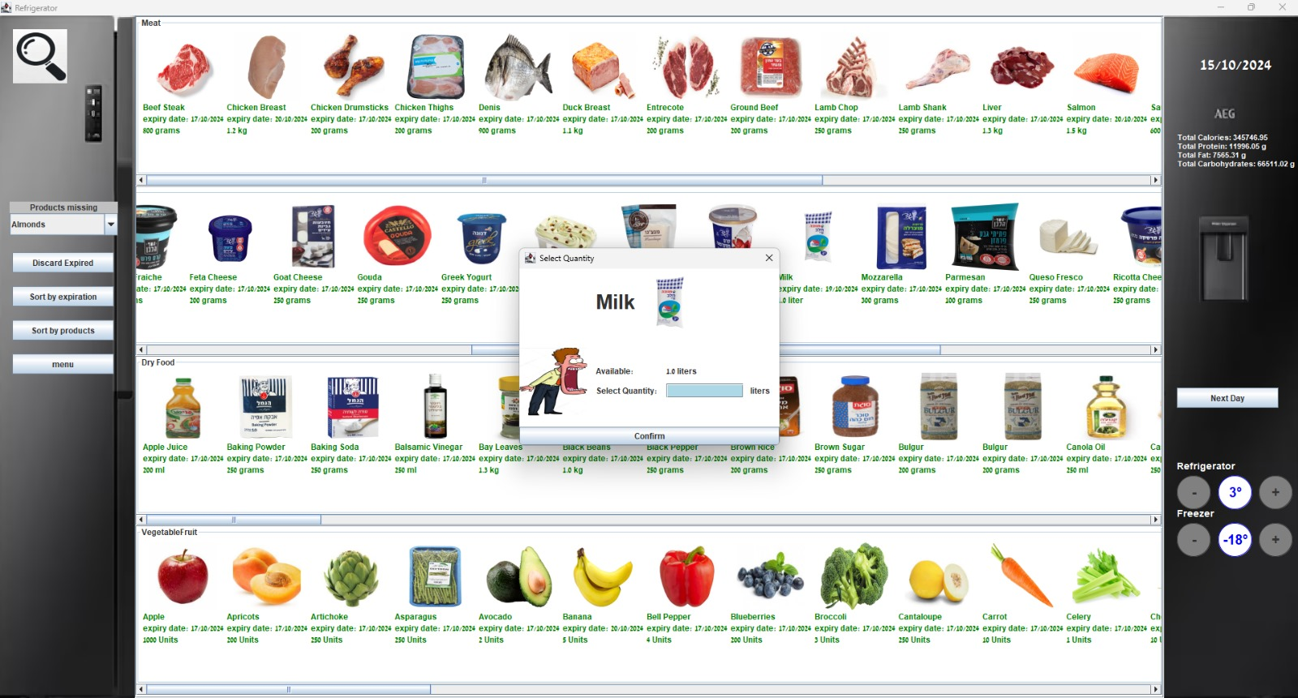

Slide 8
Thank You!
any questions?
Yuval Harary
Paz Snapir
Malachi Vinizky
Rotem Danino
yuval93813g@gmail.com
pazsnapir@gmail.com
malachivini@gmail.com
rotemdanino1@gmail.com

